Slide 1
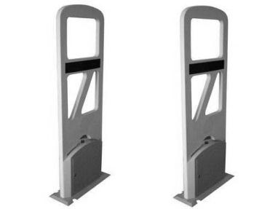

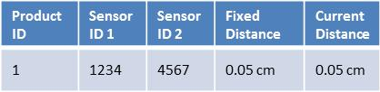

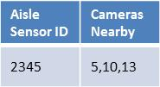

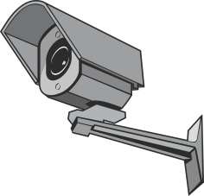

Product Sensor 1 ID | Product Sensor 2 ID | Aisle Sensor ID | Time taken to receive distress signal
1234 | 4567 | 2345 | 1.05s
1234 | 4567 | 2346 | 1.12s
Sensor Screener
Product Sensor 1234
Product Sensor 4567
Product Sensor Database
System
Aisle Sensor 2345
Aisle Camera Database
Aisle with Sensor
Security Camera 5
Store Security

